Slide 1

Housekeeper Scheduling System
Presented By
Yerra Harshitha
Shreeshma Vittal Halaki
Subashini Kannan
Sura Vamsi Kumar Reddy
Thanmai Janaki
Vaka Venkata Rakesh Reddy
Vignesh G
Vurimi Sai Manoj Kumar

Slide 2
Hello Everyone!
I’m Harshitha, acting as team lead for the group. We are group of 8 members.
Meet the Group!
Harshitha
Shreeshma Vittal Halaki
Subashini Kannan
Sura Vamsi Kumar Reddy
Thanmai Janaki
Vaka Venkata Rakesh Reddy
Vignesh G
Vurimi Sai Manoj Kumar

Slide 3
What are we going to cover today?
Business Problem
Target users
Technologies used
Challenges in Current Housekeeping Scheduling
Solution: Housekeeper Scheduling System
Implementation Process
How the System Works
Key Benefits for Management
Key Benefits for Housekeeping Staff
Conclusion
Q&A
Thank you!

Slide 4
Business Problem
1
Database Schema Design – Identify domain objects, Create Database tables
In order to clean rooms of the hostel students on time a dynamic, responsive web application is required.
The application should be responsible to register a student, should allow student to login in the application, to accept requests from the students for cleaning the room, should be able to capture the feedback for a service, should be able to add, edit and delete house keepers, enable/disable house keepers, communicate back and forth with the student/users. The application should also support multiple devices.
2
Front End Development – Static web pages using Angular
3
Back End Development– RESTFUL Web API to perform CRUD operations using Spring Boot and MySQL
4
Unit Testing – Unit Testing with Junit framework, Functional testing using POSTMAN

Slide 5




Target Users
Admin
Hostel students/User
House Keepers
Technologies Used
Front-end
Server-side
Back-end:
Server:

Slide 6
Challenges Faced
01
02
03
04
Manual scheduling
Difficulty in tracking
Inefficient use of time and resources
Lack of transparency
Manual scheduling leading to errors and confusion
Difficulty in tracking availability and tasks
Inefficient use of time and resources, Last-minute changes causing disorganization
Lack of transparency between management and housekeeping staff

Slide 7
OUR Solution
Housekeeper Scheduling System application developed with the user in mind, is functional, secure, and perform well with rich and user-friendly interface.
Automated scheduling based on housekeeper availability, skill level, and workload
User-friendly interface for both Admin and housekeepers
Real-time tracking of tasks and progress
Centralized platform for assigning and managing tasks
Easy updates to schedules, with instant notifications for staff

Slide 8
Implementation Process
Scrum
User Interface
Security
Design
Technology
Hosting
Testing
Deployment

Slide 9
How the System Works (Overview of the Process):
Input Availability: Housekeepers can input their availability.
Assigning Tasks: Admin can easily assign tasks based on availability and skills.
Real-Time Updates: Housekeepers receive real-time notifications for new or updated tasks.
Task Completion: Housekeepers can mark tasks as completed, and the admin is notified.
Reporting: The system generates reports for efficiency, task completion, and staff performance.

Slide 10
Key Benefits for Management
Improved Efficiency:
Automates task assignments, reducing manual work
Minimizes scheduling conflicts
Ensures optimal use of resources
Enhanced Communication:
Real-time updates and notifications
Easier collaboration between teams
Better Task Visibility:
Track progress and completion of tasks in real-time
Insights into staff performance and productivity

Slide 11
Key Benefits for Housekeeping Staff
Clear Scheduling:
Transparent schedules accessible via mobile or desktop
Reduced confusion with instant updates and changes
Efficient Task Management:
Easy task tracking with real-time status updates
Ability to manage workload based on preferences and availability
Improved Work-Life Balance:
Staff can input their availability, reducing overtime or burnout

Slide 12
Screenshots
Conceptualize ideas – reference wireframes in the requirement document helped us to visualize ideas and document solutions
Early feedback – Deliver concept of core functions of the product more effectively and gather feedback at an early stage within the team.
Responsive – To support different screen resolutions for the devices . Bootstrap frame used to achieve responsive ness to the screen resolution. The goal was to provide information to users irrespective of the screen size.
Functional features of the application were derived from the requirement specifications document. Visuals. Critical & complex admin and student/user challenges were brainstormed, analyzed and code is stored in the GitHub.

Slide 13
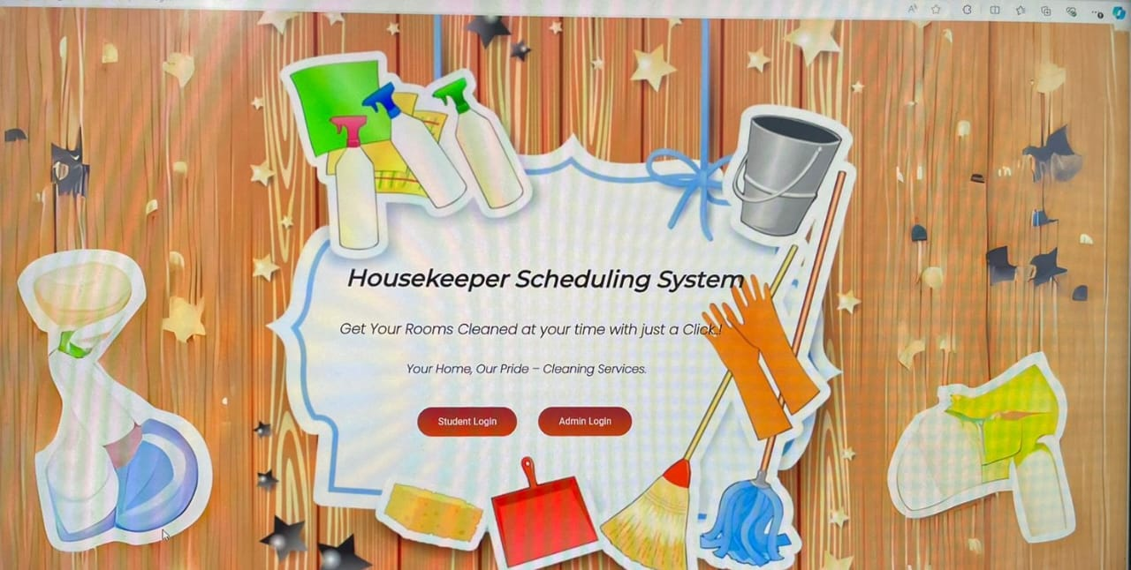

Slide 14
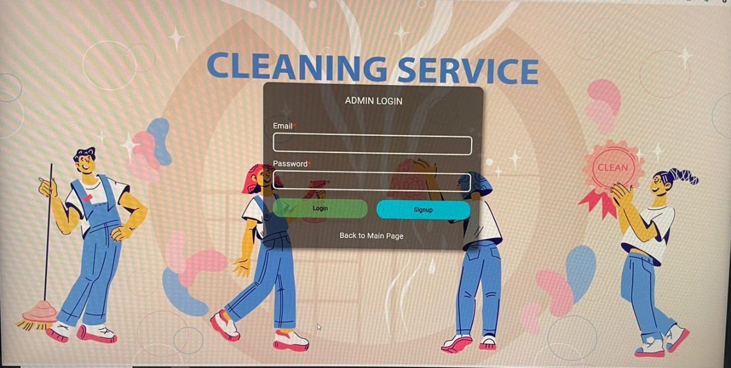

Slide 15
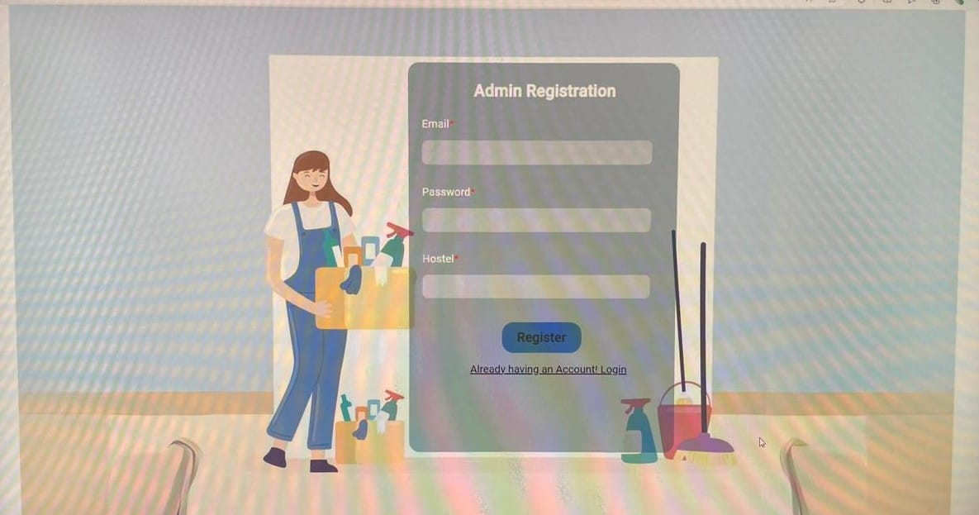

Slide 16
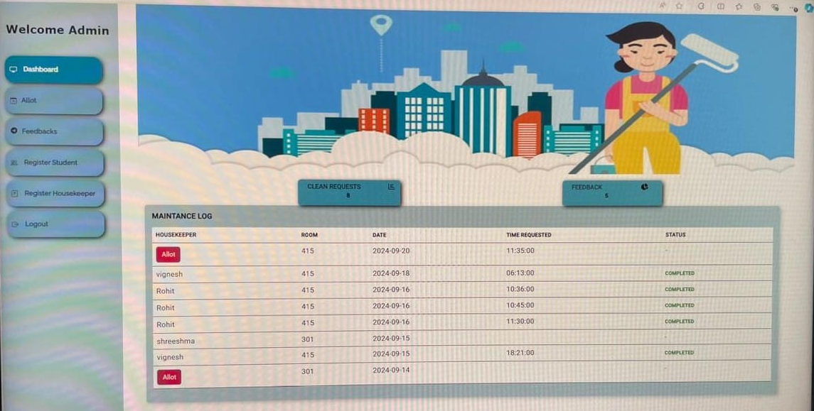

Slide 17
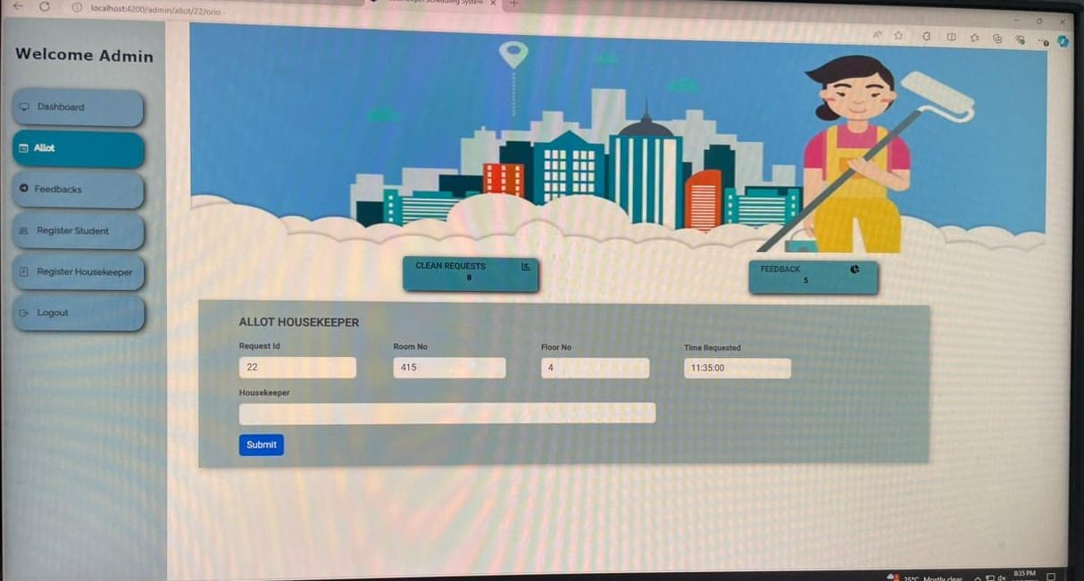

Slide 18
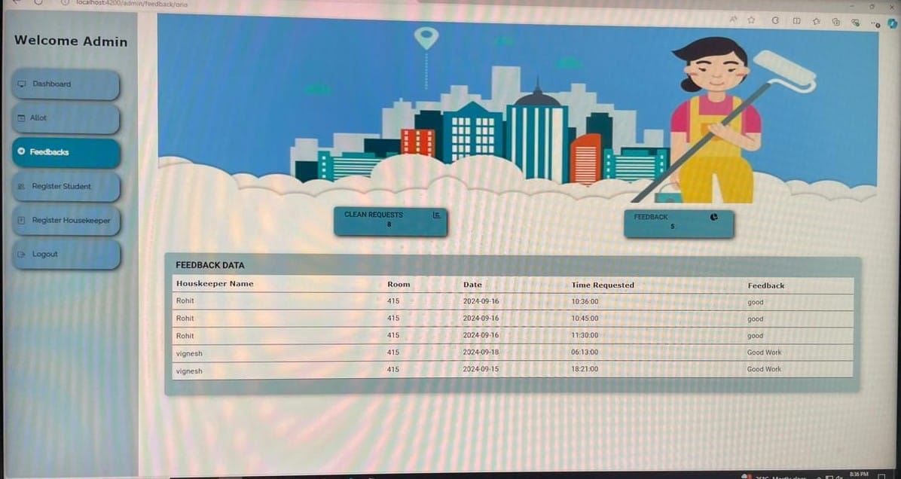

Slide 19
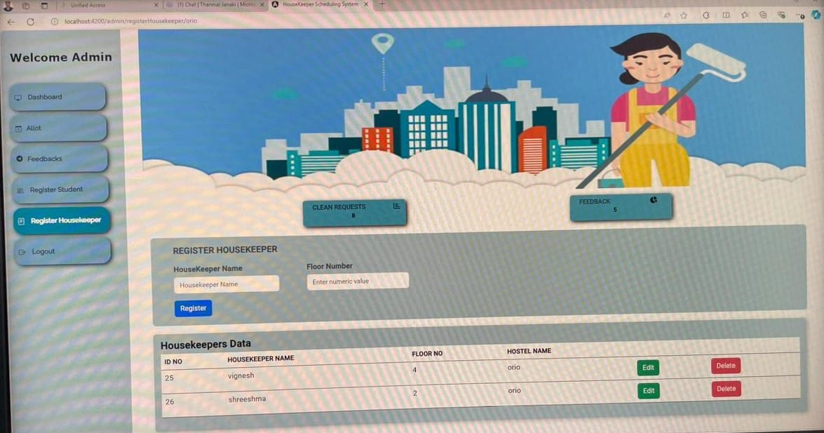

Slide 20
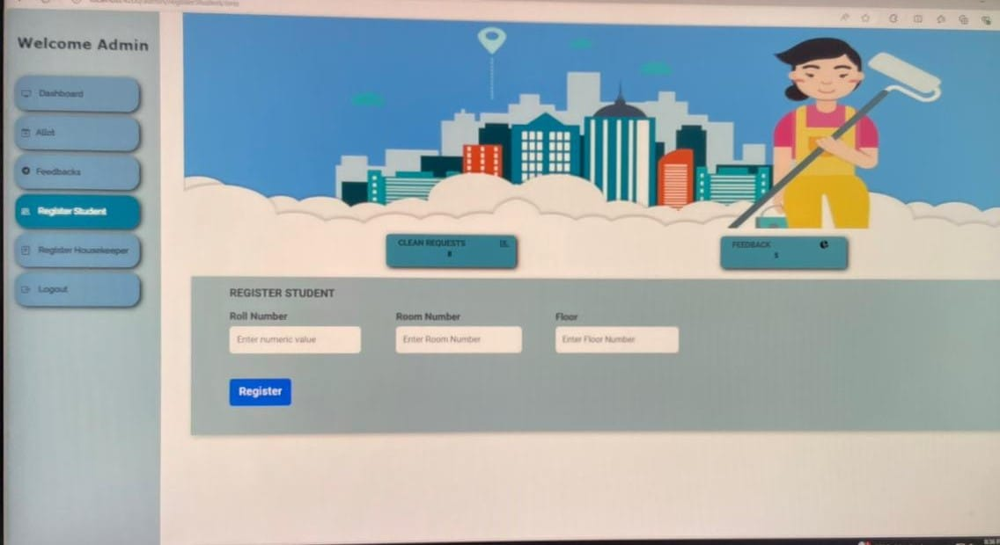

Slide 21
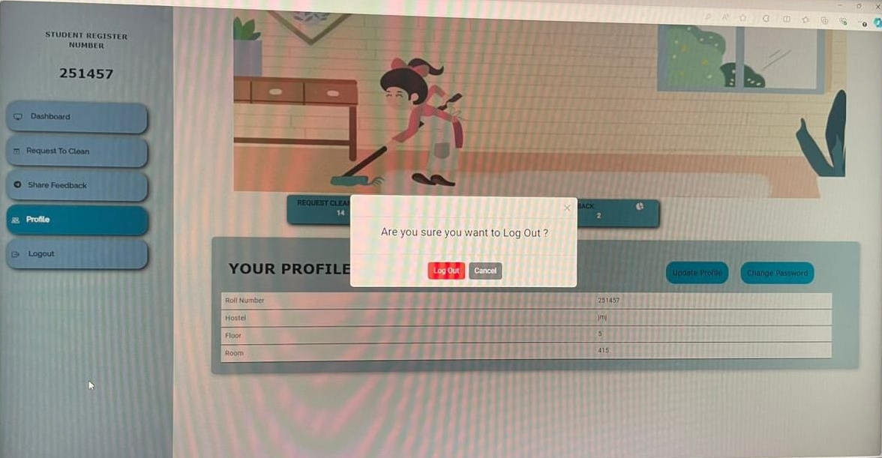

Slide 22
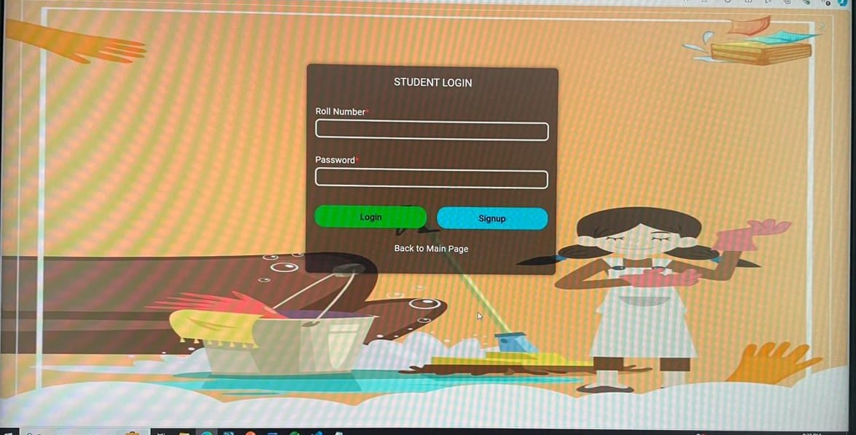

Slide 23
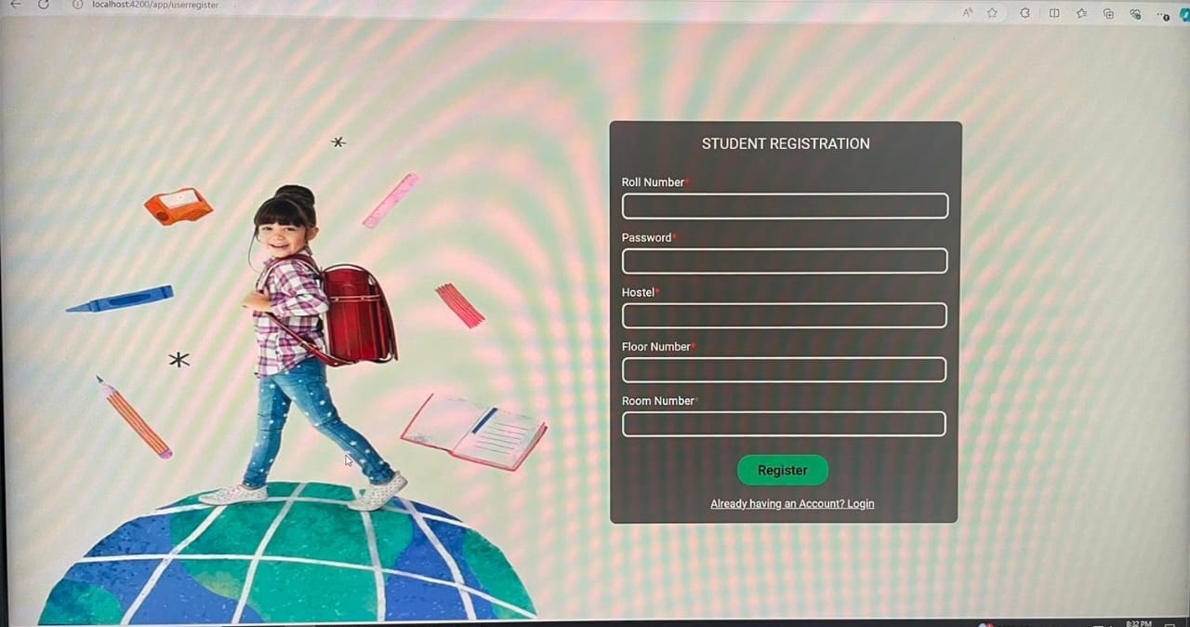

Slide 24
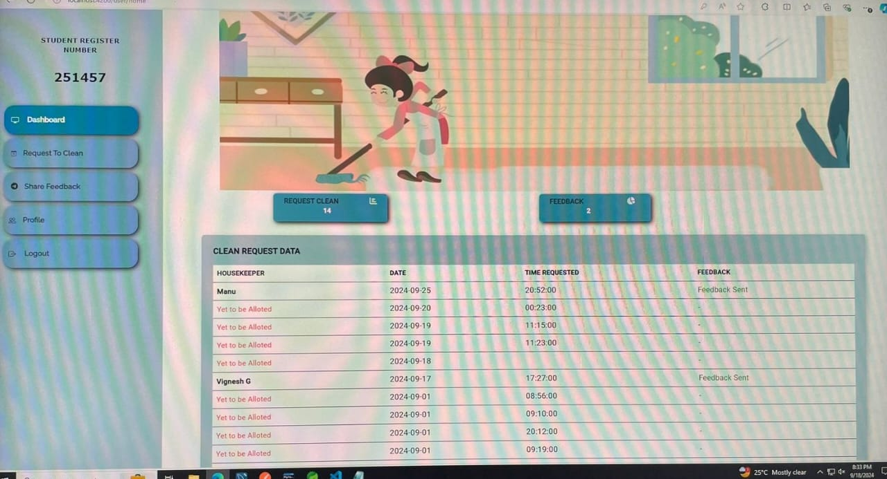

Slide 25
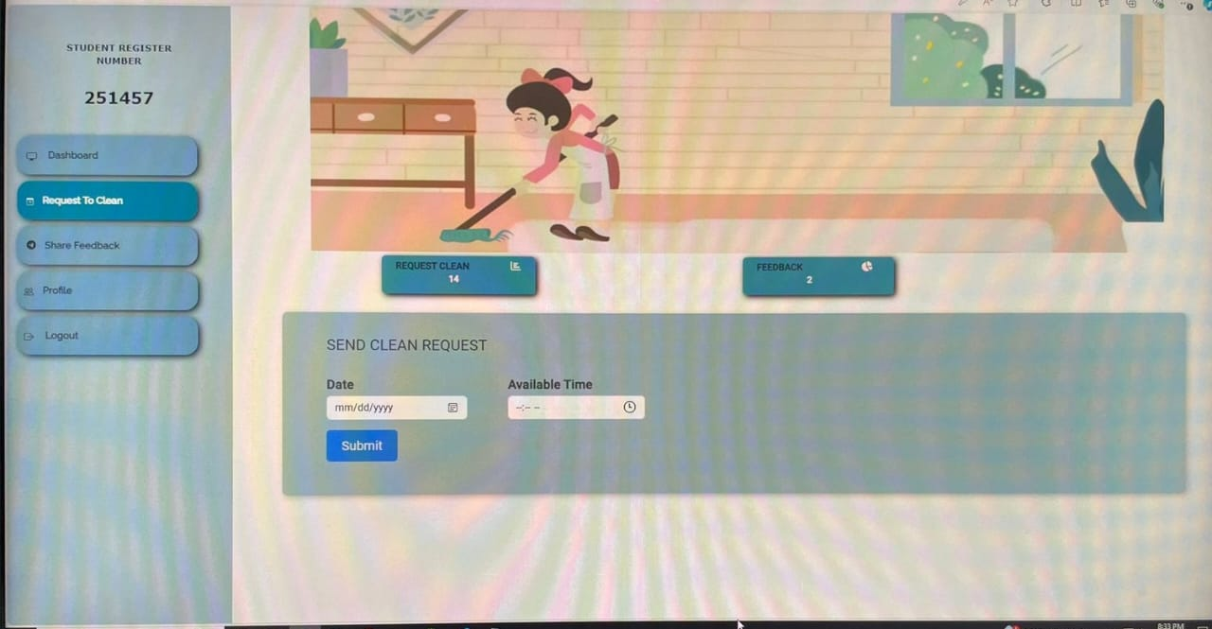

Slide 26
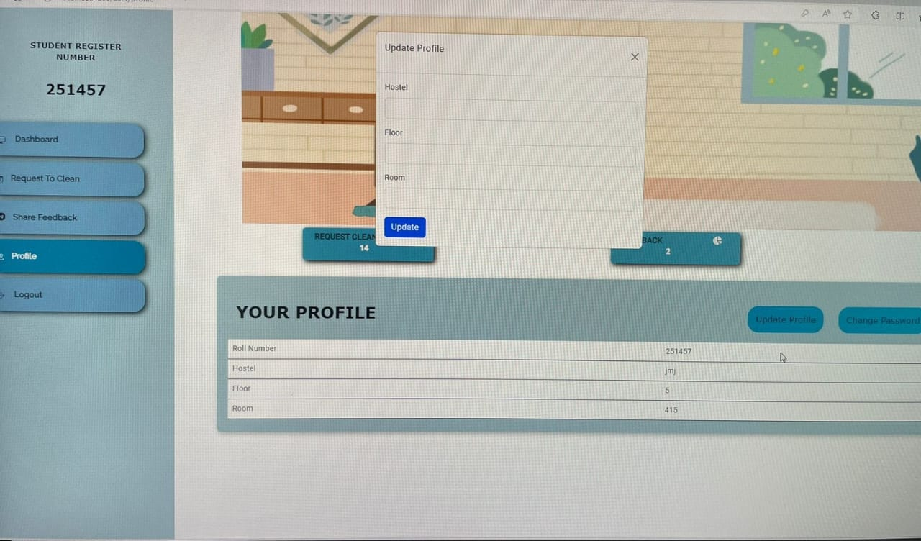

Slide 27
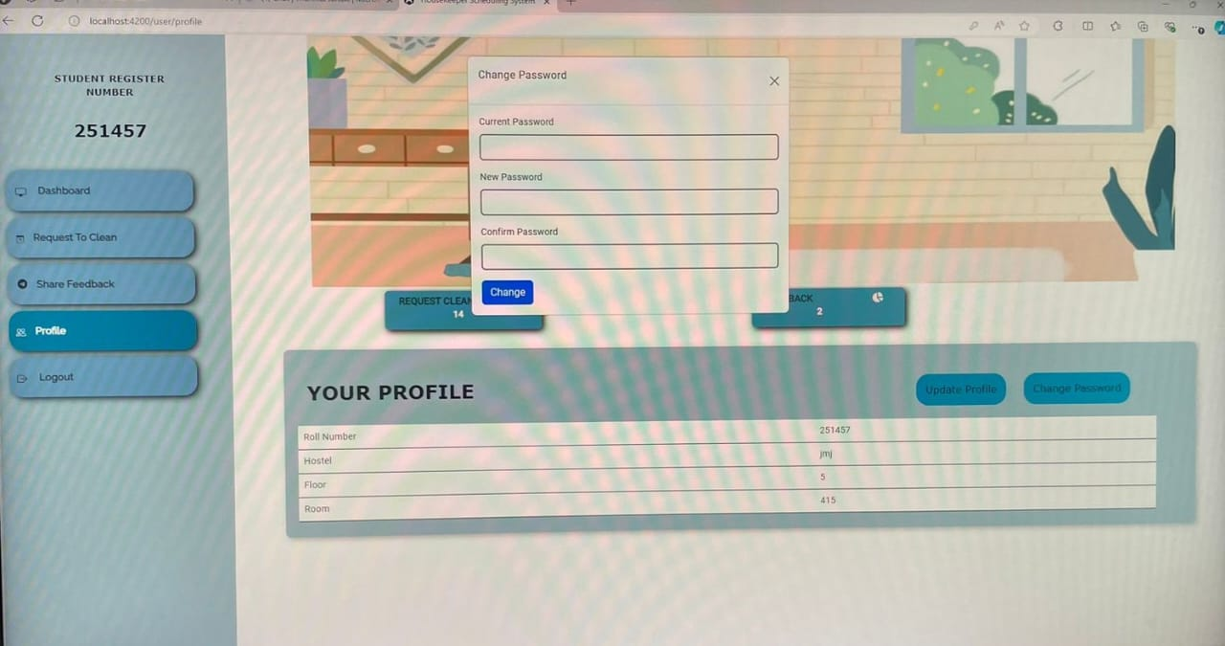

Slide 28
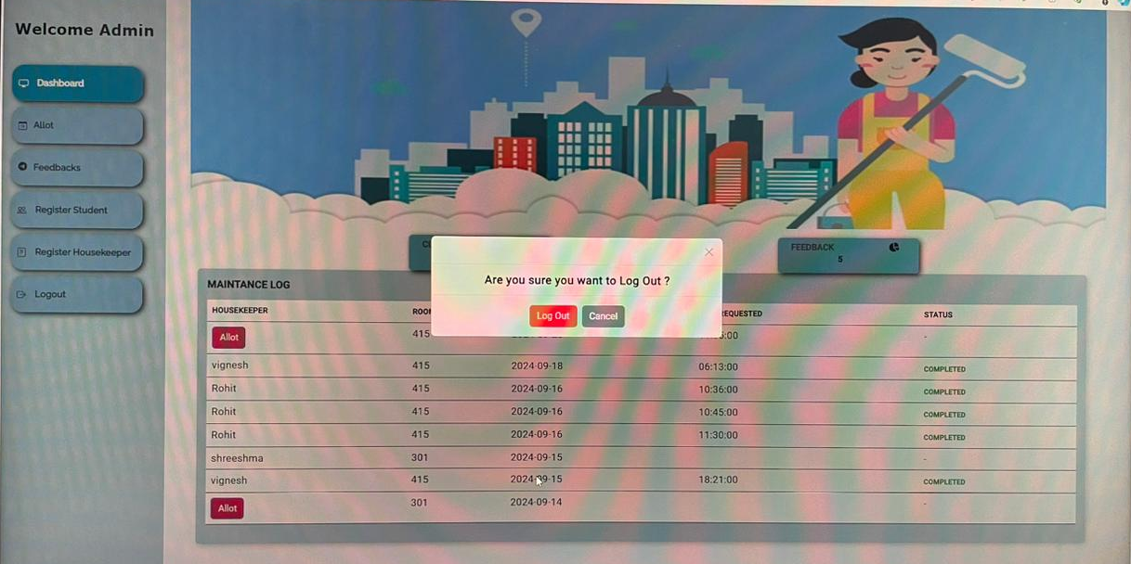

Slide 29
Conclusion

Slide 30
Conclusion
The Housekeeper Scheduling System was successfully developed to make housekeeping operations more efficient and organized. By automating scheduling, improving communication, and tracking tasks in real-time, the system has solved key challenges like manual errors and scheduling conflicts.
Key Achievements:
Automated task assignments based on availability and skills
Real-time notifications and updates for both managers and housekeepers
Easy-to-use interface accessible on both mobile and desktop devices
Task tracking and reporting tools to monitor staff performance and efficiency
Challenges Solved:
The system is scalable, meaning it can handle more users and tasks as the business grows.
It balances being feature-rich while staying user-friendly for all staff.
Future Enhancements:
We could add predictive scheduling using machine learning and integrate with other business tools like payroll and HR systems.
Conclusion: Overall, the Housekeeper Scheduling System achieves its goals of making scheduling easier, improving communication, and increasing productivity.

Slide 31
Any Questions for us?
Happy to Address!

Slide 32
Thank you!

